Slide 1

Resume sorting and analysis website
Powered by advanced AI algorithms.

Slide 2
Introduction
Resume sorting and analysis website aims to revolutionize the way companies handle recruitment. Utilizing sophisticated AI algorithms, our platform will not only automate the sorting of resumes but also offer comprehensive descriptions and assessments of candidates. These AI-generated insights will help hiring managers make more informed decisions, ensuring that they select the best candidates quickly and fairly.

Slide 3

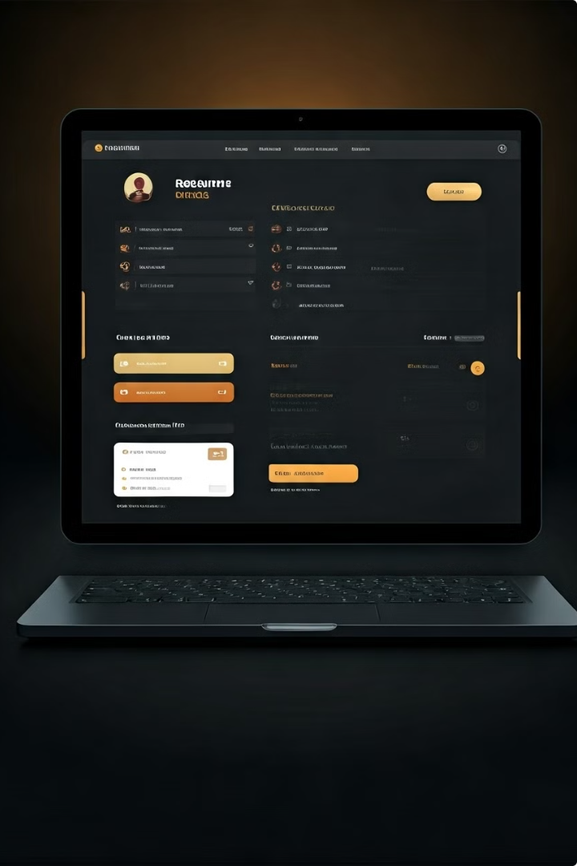
Problem statement
Managing and sorting the voluminous number of resumes received by hiring managers and HR for each job opening encounter significant challenges. It is not only time-consuming but also susceptible to human biases and inconsistencies. As a result, qualified candidates may be overlooked, and the hiring process can be unduly prolonged.
By leveraging AI, we can automate the screening process, reduce biases, and provide deeper insights into each candidate’s qualifications and suitability for the role . This not only saves valuable time for HR teams but also ensures to provide deeper insights into candidates' qualifications and potential fit for the role, going beyond what is typically discernible from a manual review. These insights can help hiring managers make more informed decisions, ultimately leading to better hiring outcomes and a stronger workforce.

Slide 4

Key features of the proposed system
Automated Resume Screening: Utilizes AI to automatically screen and rank resumes based on job-specific criteria, significantly reducing the time required for initial candidate evaluation.
Keyword and Skill Matching: Analyzes resumes to identify relevant keywords and skills, ensuring alignment with job descriptions and role requirements.
Bias Mitigation: Employs algorithms designed to minimize human biases by focusing on objective qualifications and skills rather than demographic information.
Standardized Evaluation Metrics: Establishes consistent and objective metrics for resume evaluation, allowing for fair and comparable assessment of all candidates.
Candidate Insights and Recommendations: Provides detailed AI-generated insights and recommendations about candidates, highlighting their strengths, potential fit for the role, and areas for further assessment.
Integration with ATS: Seamlessly integrates with existing Applicant Tracking Systems to streamline workflow and data management.
User-Friendly Interface: Features an intuitive interface that allows HR professionals to easily navigate, review, and manage candidate information.

Slide 5

Modules
User Interface (UI) Module
Purpose: To provide a seamless and intuitive experience for HR professionals and hiring managers.
Components:
Dashboard for job openings and application management
Resume upload and parsing interface
Candidate profile views
Analytics and insights visualization
Resume Parsing Module
Purpose: To extract and standardize information from various resume formats.
Components:
Optical Character Recognition (OCR) for extracting text from PDFs and images
Natural Language Processing (NLP) for understanding and categorizing resume content
Data normalization and structuring
AI Screening and Ranking Module
Purpose: To automatically screen and rank resumes based on job-specific criteria.
Components:
Machine learning algorithms for resume scoring
Job description and resume keyword matching
Skill extraction and relevance analysis
Candidate Insights Module
Purpose: To provide detailed AI-generated descriptions and assessments of candidates.
Components:
Personality and fit analysis based on resume content
Predictive analytics for job performance
Strengths and areas for development

Slide 6
Modules
Bias Mitigation Module
Purpose: To reduce biases and ensure fair evaluation of all candidates.
Components:
Algorithms to anonymize resumes by removing identifiable information
AI models trained to focus on skills and experience rather than demographic details
Fairness checks and balances
Integration Module
Purpose: To ensure seamless integration with existing Applicant Tracking Systems (ATS) and other HR tools.
Components:
APIs for data exchange between the platform and ATS
Import and export functionalities for candidate data
Synchronization with calendar and email systems for interview scheduling
Data Security and Privacy Module
Purpose: To protect sensitive candidate information and comply with data privacy regulations.
Components:
Data encryption for storage and transmission
Access control and authentication mechanisms
Compliance with GDPR, CCPA, and other relevant regulations
Analytics and Reporting Module
Purpose: To provide insights into the recruitment process and candidate metrics.
Components:
Dashboards for tracking hiring progress and performance
Reports on candidate diversity, hiring timelines, and sourcing effectiveness
Customizable analytics based on user needs

Slide 7
Modules
Feedback and Improvement Module
Purpose: To continuously improve the AI models and platform based on user feedback and new data.
Components:
User feedback collection mechanisms
Continuous model training and updates
Performance monitoring and error correction
Support and Documentation Module
Purpose: To provide users with the necessary help and resources to effectively use the platform.
Components:
User manuals and documentation
FAQ and knowledge base
Customer support
User Registration and Authentication
Description: Users can create accounts and log in to the system.
Features:
Registration (email, password)
Login/Logout
Password recovery.
User Profile Management
Users can manage their personal information and preferences.
View/Edit profile information
Upload profile picture
Manage preferences

Slide 8
Modules
Resume Creation
Users can create and edit resumes.
Input personal, educational, and professional information
Select resume templates
Auto-generate content using AI
Real-time suggestions and improvements.
Resume Templates
Description: Provides a variety of professional templates.
Features:
View available templates
Preview templates
Select and apply templates
AI Content Generation
Description: Leverages AI to improve and generate resume content.
Features:
Suggest improvements
Auto-generate sections (e.g., summary, skills)
Grammar and spell check
Resume Export
Description: Allows users to export their resumes.
Features:
Export as PDF
Export as Word document
Share via email

Slide 9

Technology Stack
Frontend
HTML, CSS, JavaScript , React.js
Backend
Node.js
Database
MongoDB
AI Integration
OpenAI GPT for content generation

Slide 10
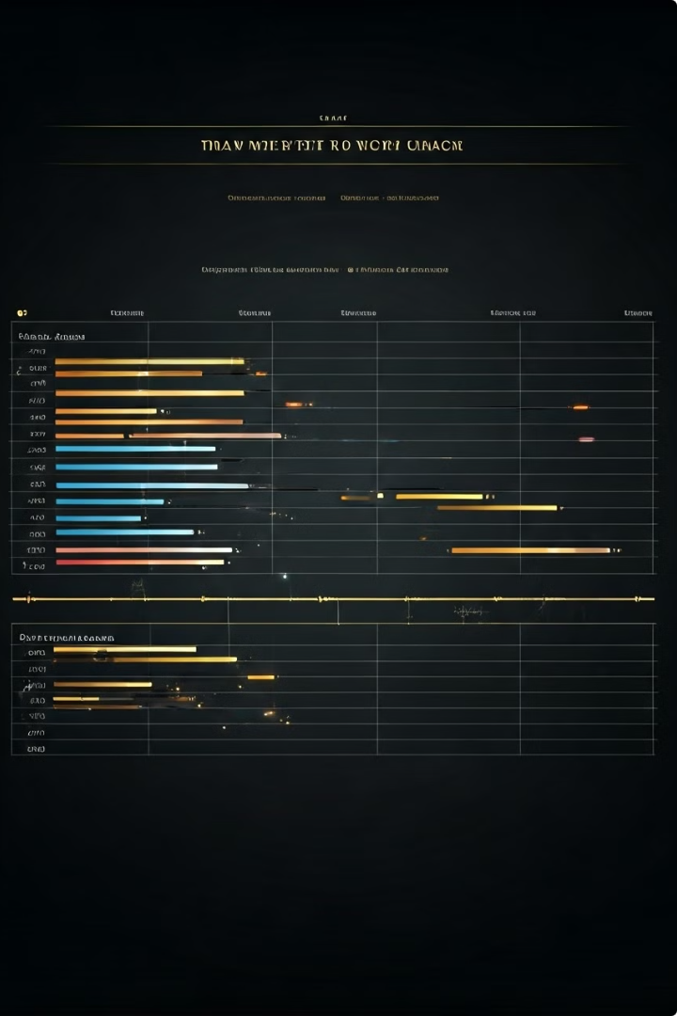
Gantt chart
 | Start Date | End Date | Actual | Delay | WEEKS
Pre Planning | 15-06-24 | 22-06-24 |  | NO | 1 week
Planning | 23-06-24 | 06-07-24 | 13-07-24 | 1week | 4week
Design | 07-07-24 | 17-08-24 |  |  | 6week
Development | 18-08-24 | 31-08-24 |  |  | 5week
Break
Build | 05-10-24 | 02-11-24 |  |  | 4week
Testing | 03-11-24 | 16-11-24 |  |  | 2week
Deployment | 23-11-24 | 14-12-24 |  |  | 3week

Slide 11
THANK YOU
FIRST UP CONSULTANTS

